Slide 1
New trends for smart grids
Integration of Renewable Energy: Smart grids support solar and wind energy integration for cleaner power generation.
Advanced Metering Infrastructure (AMI): Smart meters enable two-way communication between utilities and consumers for real-time monitoring and billing.
Energy Storage Systems: Batteries store excess renewable energy and supply it during peak demand or power outages.
Electric Vehicle (EV) Integration: Smart grids manage EV charging loads and support Vehicle-to-Grid (V2G) technology.
Artificial Intelligence & Data Analytics: Used for load forecasting, fault detection, and efficient grid management.
Cybersecurity: Protects smart grid communication networks from cyber attacks and data breaches.
Microgrids & Distributed Generation: Localized power systems that can operate independently or with the main grid, improving reliability.

Slide 2
Topology analysis
Logical topology
In practice, multiple power and communication lines can exist among the nodes, so that the physical topology can form a mesh network
For example, a power utility is linked to multiple substations, while the substations belong to a single power utility
Smart grids can use two separate lines: the power line and the communication line.
The two lines logically form the same topology, which is the tree-like topology.

Slide 3
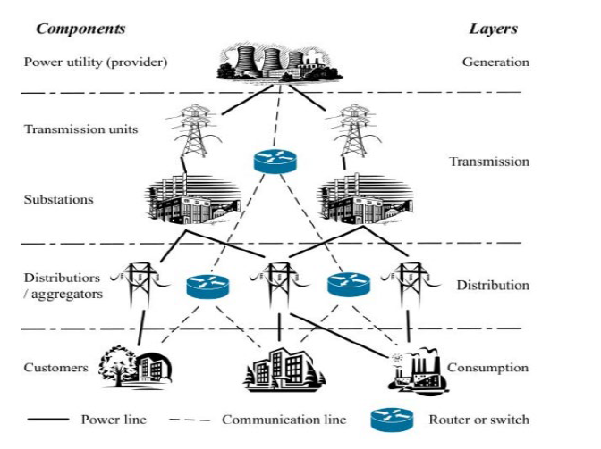
Topology analysis

Slide 4
Topology analysis
Generation Layer – Power Utility (Provider)
The power plant generates electricity.
Its function include produce electrical energy, send power to transmission lines
Power then moves through high-voltage transmission lines.
Transmission Layer – Transmission Units
This layer contains: Transmission towers, High-voltage transmission lines, Communication routers/switches.
This unit transport electricity over long distances from power plants to substations and uses high voltage to reduce power loss.
The routers/switches allow monitoring and control of the power grid.

Slide 5
Topology analysis
Substations
Step down voltage (e.g., from 400 kV to 33 kV or 11 kV).
Control switching operations and monitor power flow.
They act as a bridge between transmission and distribution networks.
Distribution Layer – Distributors / Aggregators
This layer sends power from substations to local areas.
Components: Distribution transformers, Aggregators, Communication routers
Its functions include deliver electricity to residential and commercial areas., collect data from smart meters and devices.
The communication network allows load monitoring, fault detection and demand management.

Slide 6
Topology analysis
Consumption Layer – Customers
At the bottom are end users: Houses, Commercial buildings, Industries
They consume electricity.
In a smart grid, customers may also:
Send usage data back to the utility
Participate in demand response
Generate power (solar panels)
Communication Network connect power plants, substations, distribution units, and customers. It enable real-time monitoring, smart metering, fault detection and grid automation. This is what makes the grid a Smart Grid.

Slide 7
Power flow analysis.
Power flow analysis is the study used to determine the voltage magnitude, voltage angle, real power (P), and reactive power (Q) at different buses in a power system under steady-state conditions.
It helps to understand how electrical power flows from generation through transmission and distribution to consumers.
The main objectives of power flow analysis are to determine power flow in transmission lines, voltage levels at buses, and power losses in the system.
This information is essential for power system planning, operation, and control.

Slide 8
Power flow analysis.
In load flow studies, buses in the power system are classified into three types:
Slack (Reference) Bus – Voltage magnitude and angle are specified; it balances system power losses.
PV (Generator) Bus – Real power and voltage magnitude are specified; reactive power is calculated.
PQ (Load) Bus – Real and reactive power are specified; voltage magnitude and angle are calculated.
Common methods used for power flow analysis include Gauss–Seidel method, Newton–Raphson method, and Fast Decoupled Load Flow method.
Thus, power flow analysis is an important tool used to ensure efficient, reliable, and stable operation of power systems.

